Slide 1


HCP Performance & Enrollment Insights
Dashboard Analysis Report

Slide 2
Key Metrics
392
14K
24.14
15.08%
Total HCP Count
Total Enrollments
Average NPS
Average Discontinuation Rate
healthcare providers
Net Promoter Score

Slide 3

HCP Distribution
By Experience
Rx Duration Analysis:
0-1 Years: ~280 HCPs (Highest count)
1-3 Years: ~210 HCPs
3-5 Years: ~180 HCPs
5-10 Years: ~150 HCPs
10+ Years: ~100 HCPs
Key Insight: Majority of HCPs have less than 3 years of prescription experience

Slide 4
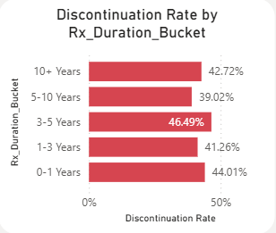
Discontinuation Analysis
By Experience
Discontinuation Rate by Experience:
Highest risk: 0-1 Years experience (needs intervention)
Lowest risk: 1-3 Years and 10+ Years
Average discontinuation rate across segments: 15.08
Key Insight: New HCPs require additional support to reduce discontinuation

Slide 5
Year-over-Year Trends
Performance Overview
2022
39.79
26.58
16.21
19
2021
35.12
22.30
18.50
50
2020
32.80
20.15
19.20
75
2022 Performance:
Avg Enrollment: 39.79 (highest)
Avg NPS: 26.58
Discontinuation: 16.21
HCP Count: 19 (new cohort)
2020-2021: Larger cohorts but slightly lower performance metrics
Key Insight: Recent cohorts show improved engagement despite smaller size

Slide 6

NPS Performance
Overall & Segmented
Overall NPS
Best NPS Range
24.14 (Positive but room for improvement)
0.00 - 48.28 across segments
Key Insight: NPS varies significantly by segment, indicating opportunities for targeted improvement

Slide 7

Report
Conclusion
Strong foundation with 392 HCPs and 14K enrollments
Clear performance patterns by experience level
Opportunities for growth in retention and satisfaction
Data-driven approach for future strategy

Slide 8
THANK YOU

